Slide 1
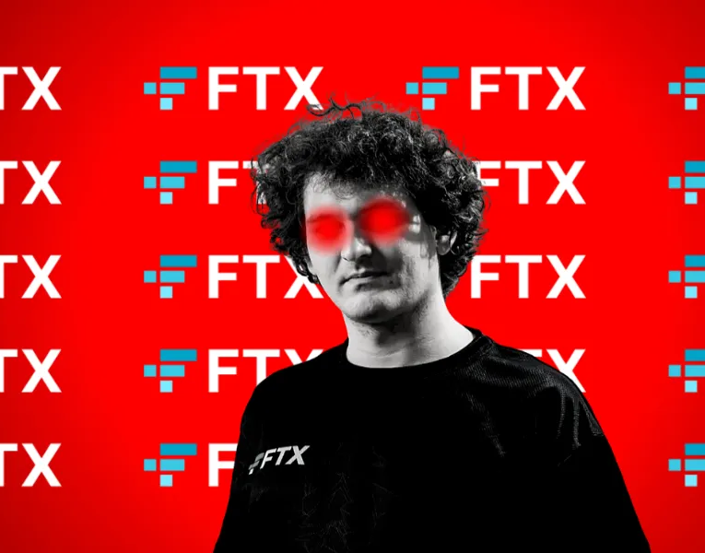
The FTX Crash: A Case Study in Operational Failure

Slide 2
Introduction to the FTX Saga
Emergence: FTX was launched in 2019 by Sam Bankman-Fried to create an innovative cryptocurrency exchange within the digital economy.
Vision and Growth: The platform quickly gained popularity due to its robust security, advanced trading features, and user-friendly interface, positioning itself as a leader in financial technology.
Peak and Perception: By 2022, FTX had reached a peak valuation of over $32 billion, drawing attention and credibility through celebrity endorsements and strategic partnerships.
Underlying Challenges: Despite its success, issues like the questionable handling of customer funds and unclear risk management practices began emerging, ultimately leading to a significant crisis affecting both FTX and the broader cryptocurrency market.

Slide 3
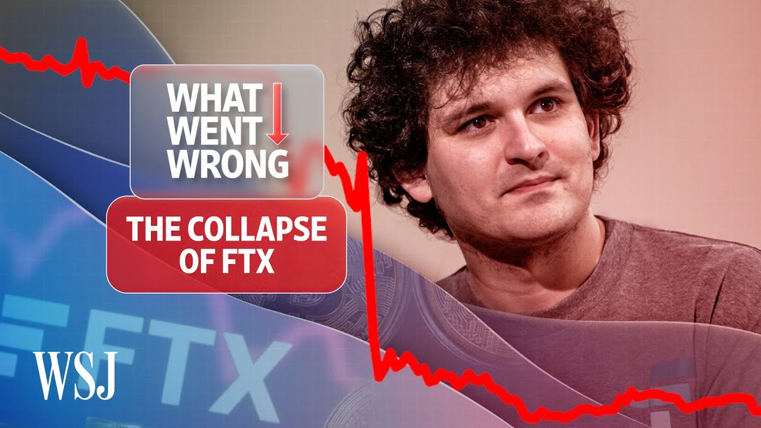

Slide 4
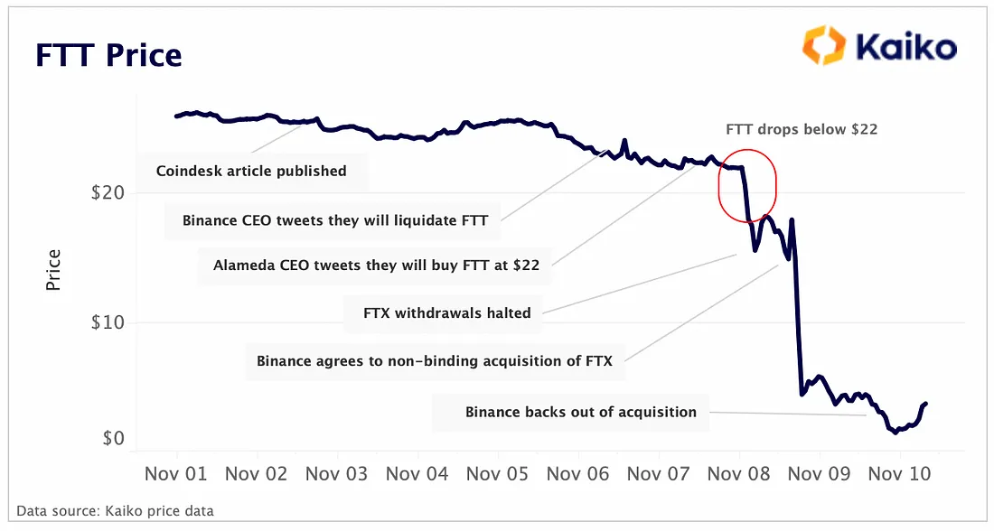
A Failed Promise by FTX’s
FTX had advertised that it was built on "industry-leading risk management systems" and boasted of an automated "risk engine" that was supposed to monitor risk 24/7.
Despite claims of a robust risk engine, it was ineffective due to structural setups that favored Alameda’s risky operations.
The risk management tools were sidelined by practices that prioritized Alameda’s needs over customer security.
The gap between advertised risk management and actual practices contributed significantly to FTX’s collapse
Notes:
FTX risk management strategies were working or were waiting to fail since 2019 , it is suggested that LUNA crash had a significant affect on Alameda a sister company of FTX owned by Sam Bankman Fried (SBF) ,
Alameda’s Investment in LUNA had affected its assets and to save Alameda SBF resorted illegal means to save Alameda

Slide 5
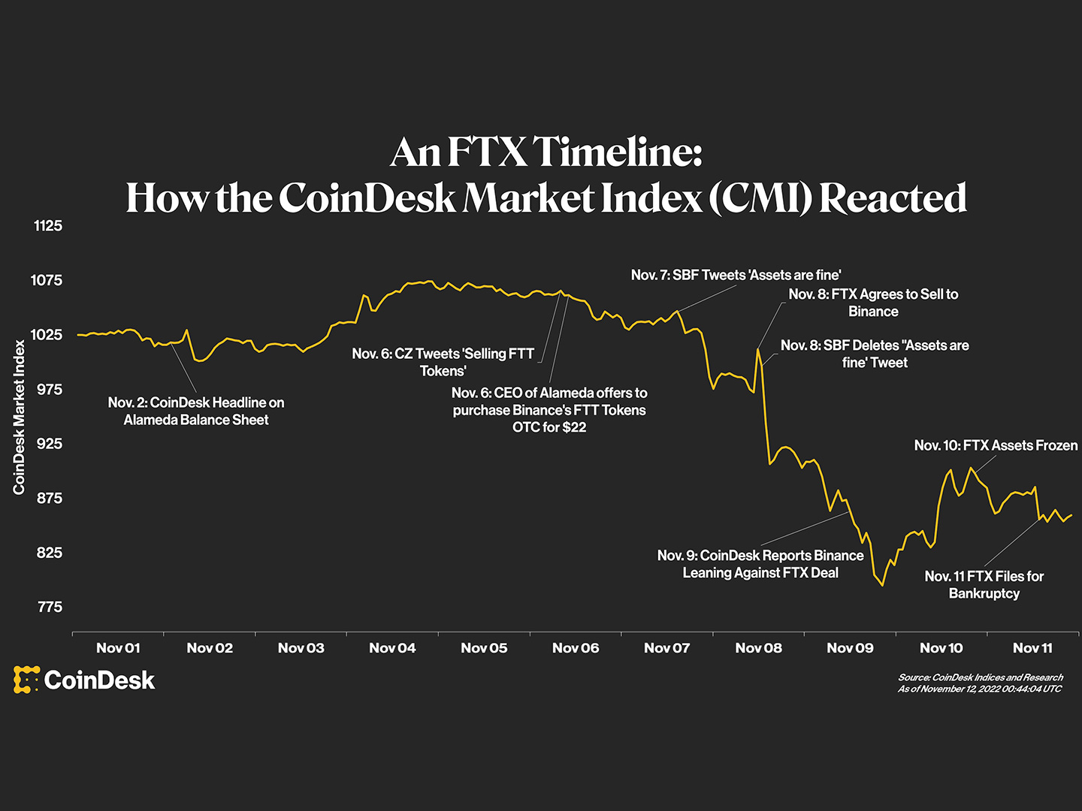

Slide 6

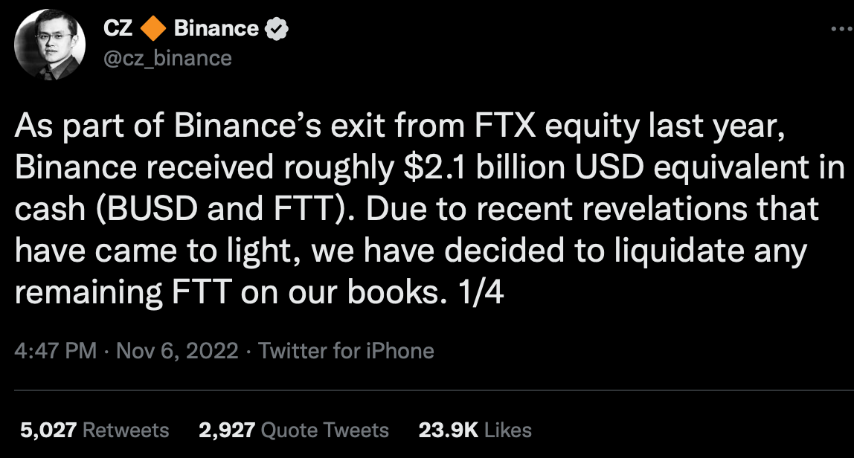
Story of Collapse: Deep Dive
The Rise of FTX
FTX, a cryptocurrency exchange founded by Sam Bankman-Fried (SBF) in 2019, experienced rapid growth and became one of the largest exchanges in the world. SBF, who also founded the crypto trading firm Alameda Research, created FTX's own token called FTT and embarked on a massive marketing and investment drive.
The Cracks Begin to Show
In November 2022, CoinDesk reported that Alameda's balance sheet was largely comprised of FTT tokens. This revelation sparked concerns about the relationship between FTX and Alameda, as well as the stability of FTT
The Withdrawal Contagion
On November 6th, Binance CEO Changpeng Zhao (CZ) announced plans to sell off Binance's FTT holdings, leading to a rapid decline in FTT's value.This sparked a wave of withdrawals from FTX, with over $5 billion in withdrawals on November 6th alone.

Slide 7

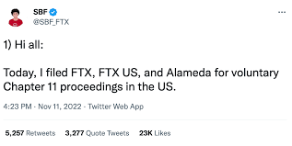

Story of Collapse: Deep Dive
The Collapse of FTX
As withdrawals continued, it became clear that FTX was facing a liquidity crisis. On November 8th, Binance announced plans to acquire FTX's non-U.S. business, but backed out the following day after conducting due diligence.
The Aftermath
On November 11th, SBF stepped down as CEO and FTX filed for Chapter 11 bankruptcy protection. It was later revealed that FTX had used customer funds to prop up Alameda Research, a clear breach of trust. The collapse of FTX led to a "crypto contagion," with other companies facing financial difficulties and the broader crypto market experiencing significant losses.
The Fallout
The collapse of FTX has had far-reaching consequences, both for the crypto industry and for those directly involved. Investors and customers have lost billions of dollars, and the incident has sparked calls for greater regulation and transparency in the crypto space. SBF has been arrested and faces civil and criminal charges from the DOJ, SEC, and CFTC.

Slide 8
What went wrong with FTX
Financial Oversight Lapses
FTX's modern interface masked internal lapses, as crucial financial safeguards were often bypassed. The blurring of lines between company assets and executive funds led to risky mingling of personal and company wealth, eroding foundational trust in the institution.
Risk Management Culture
At FTX, a culture of high-risk appetite prevailed, propelled by Sam Bankman-Fried's leadership. This culture prioritized relentless innovation at the expense of stability, neglecting the necessary risk assessments and prudent management usually inherent in financial operations.
Crisis Escalation
The exposure of FTX's core weaknesses triggered its downfall, starting with investigative reports and escalating to a liquidity crisis as customers hurried to withdraw funds, resulting in a catastrophic collapse that impacted not just FTX but the broader cryptocurrency market.

Slide 9
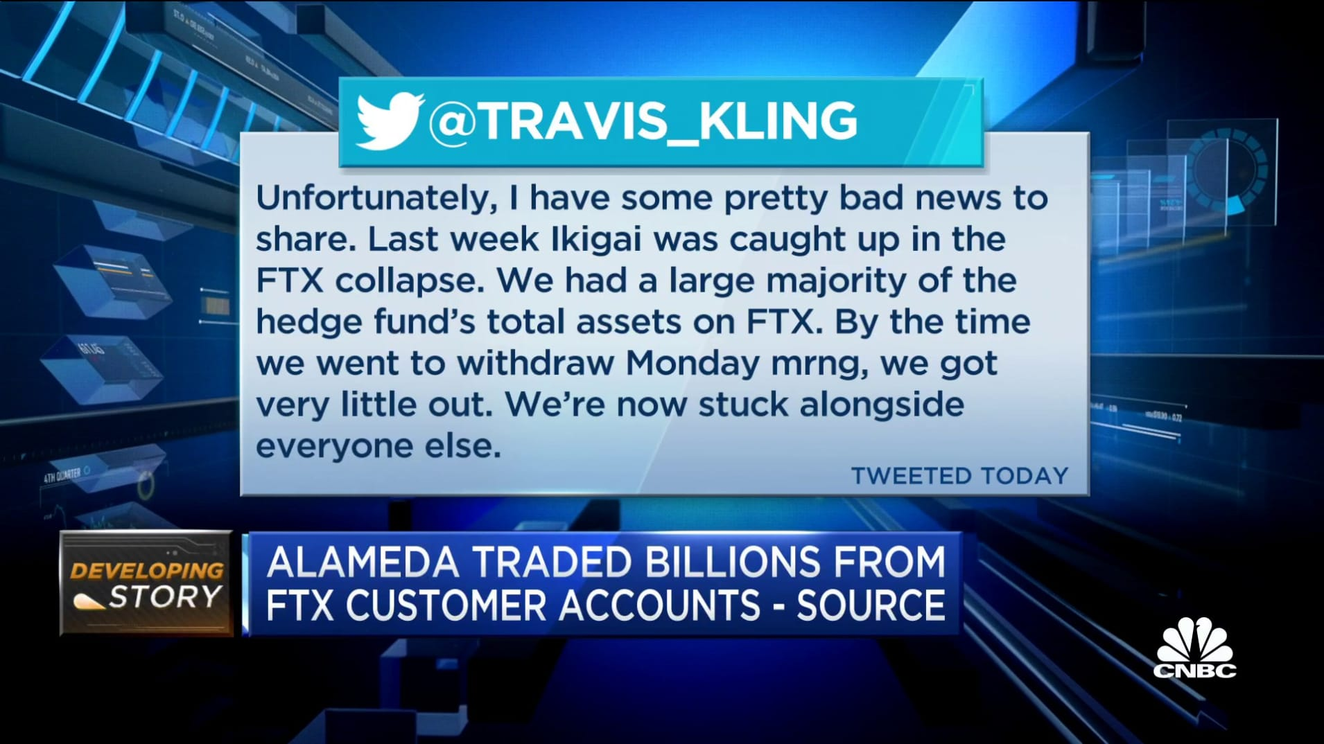
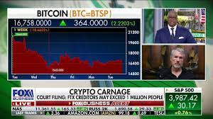
Catastrophe and Aftermath
Immediate Impact: As FTX's crisis unfolded, the full extent of its impact became evident. Global investors, from individuals to large institutions, faced significant losses. The broader community, including thousands of employees, grappled with the sudden loss of employment and the erosion of trust in the cryptocurrency sector.
Market Shockwaves: The downfall of FTX reverberated throughout the crypto market. Valuations plummeted, and investor confidence waned, leading to increased scrutiny across all crypto platforms and a reassessment of the perceived stability of digital assets.
Regulatory Response: The event did not escape global attention, prompting regulators worldwide to consider stricter oversight. This marked a turning point in the approach to cryptocurrency regulation, sparking legislative initiatives focused on enhancing consumer protection, market stability, and the transparent operation of crypto entities.

Slide 10
Literature Review
Regulatory Landscape
The cryptocurrency regulation realm is often compared to a new frontier: vast, evolving, and lacking standardized rules. In this context, FTX's rapid ascent illustrates the potential of new digital markets but also underscores the urgent need for comprehensive regulatory frameworks to mitigate the risks accompanying this growth.
Academic and Industry Perspectives
Academic studies and industry reports have consistently highlighted the risks associated with rapidly expanding financial sectors like cryptocurrency. Historical cases like the fall of Mt. Gox emphasize the dangers of operating without strict oversight.
Regulatory Shortcomings
Despite warnings, a significant gap persists between rapid innovation in the crypto space and the slower evolution of regulatory frameworks. FTX, for instance, exploited these discrepancies, operating in a regulatory environment that lagged behind its global influence and reach.
Notes:
The FTX saga has reignited debates about how to regulate the cryptocurrency industry.
The incident has prompted calls for stronger rules and enforcement from lawmakers like Senator Elizabeth Warren.
Regulators are expected to redouble their crypto enforcement activities, with the SEC potentially pursuing claims of fraud and financial misconduct.

Slide 11
Preventing Future Crises - Lessons from FTX
Governance Aspect | FTX Failure Insights | Recommended Preventative Measures
Independent Boards | The absence of an independent board led to unchecked executive decisions and risky behaviors. | Establish independent boards with experienced directors to ensure oversight and responsible governance in high-risk industries.
Internal Controls | FTX's failure in internal controls, particularly in segregating customer funds, led to significant financial mismanagement. | Implement stringent internal controls, including segregation of customer funds and centralized cash management.
Critical Roles | Lack of qualified personnel in key financial, accounting, and risk management roles contributed to poor management decisions. | Hire skilled professionals in critical roles to ensure sound decision-making and adherence to industry best practices.
Regular Audits | Inadequate auditing at FTX allowed financial discrepancies to go undetected, obscuring the true financial state. | Conduct regular and thorough audits by independent auditors to maintain accurate and transparent financial records.
Transparency | FTX's lack of transparency in operations and undisclosed conflicts of interest eroded trust and led to its collapse. | Ensure transparency in business practices, ownership structures, and disclose potential conflicts of interest.

Slide 12
Conclusion
The FTX collapse, reminiscent of the 2008 financial crisis, underscores the dangers of unchecked risk and lack of regulation. Contributing to the downfall were not only failures within the crypto industry but also questionable practices at affiliated entities like Alameda Research. To avoid repeating history, the crypto sector must adopt transparency, robust regulation, and responsible risk management. This approach will be essential for restoring trust and building a resilient, equitable financial system, requiring a concerted effort from all stakeholders.
"Understanding and integrating these lessons will not only prevent future catastrophes but also propel the industry forward into a more stable and trustworthy future."

Slide 13
References
Blockchain Research Institute. (2022). The impact of cryptocurrency regulations on global markets.
Financial Action Task Force (FATF). (2023). Global standards for cryptocurrencies and related financial services.
Roubini, N. (2022). Cryptocurrency markets: Opportunities and risks. Journal of Financial Markets.
International Monetary Fund. (2022). Regulating digital currencies: A global perspective.
Securities and Exchange Commission. (2023). Reports on cryptocurrency fraud and market integrity.
Smith, A., & Wesson, B. (2023). The fall of FTX: A case study. Cryptocurrency Case Studies Journal.
Johnson, L. (2023). Crisis in Crypto: Learning from financial collapses. Finance and Regulation.
Davis, R. (2022). Stress testing for financial institutions: How much is enough? Banking Sector Quarterly Review.
Lee, C. (2023). Ethics and accountability in financial technology companies. Journal of Business Ethics in Technology.

